Slide 1
RAJASHIVCHATRAPATI ARTS AND Commerce college,Mahagaon

Slide 2
Compulsory English
. For
B.A First Year

Slide 3
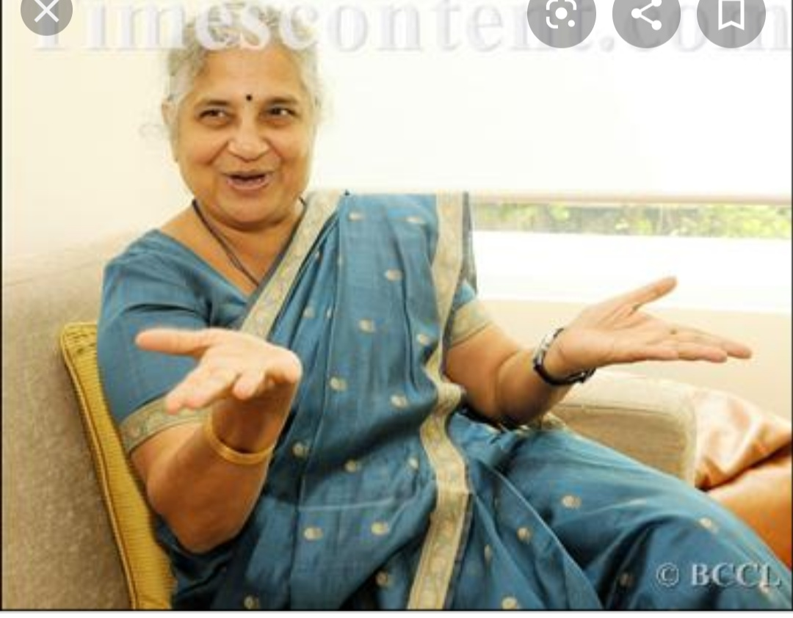
In Sahyadri Hills,A Lesson in Humility
Author :Sudha Murty
Source of the story: Wise and Otherwise a Salute to Life
Publication: 2002

Slide 4
Sudha Murty
. Sudha Murty who is holder of M.Tech.in computer science.
Reknown social worker of India
Writer of Kannada and English language
Recipient of Padmashri Rajalakshmi Awarde......

Slide 5
Kea points
Kea Points
. Hobblis of author
Her visit to Sahyadri Hills
. Beauty of Nature
Her Help to school
Message

Slide 6
Her help to school
Students were far away even from basic needs.Writer observed all the problems and difficulties faced bye student in extreme rainy season and decided to come up with some help. So she returned with cloths and umbrellas for students........

Slide 7
Hobbies of Author
She loves travelling. Be it a tiny village a drought hit area a deserted mountain top a dense forest or a new monument in Egypt or China she enjoys going to different places.

Slide 8
Her visit to Sahyadri Hills
On one occasion she went to Sahyadri Hills a densed Forest region in karnataka.It had been drizzling whole the day so it was different to communicate with people.She went there in order to help the school and it’s ambience.

Slide 9
Beauty of Nature
The mild smell of exortic trees, shrubs and flowers the chirping of different kinds of birds unpolluted breez these are joys that can never be experienced in any town or city

